Slide 1
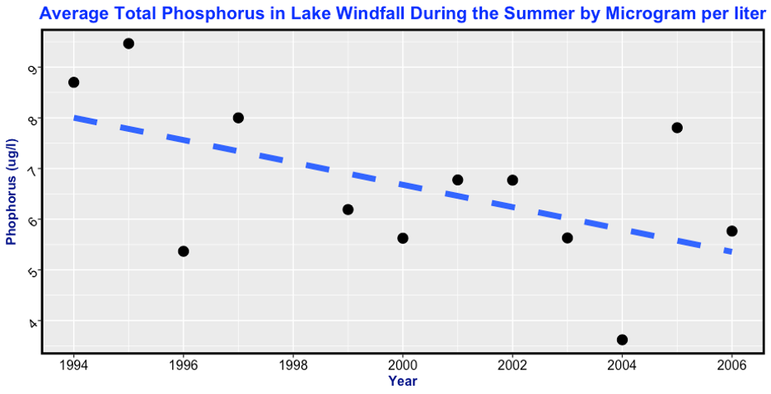
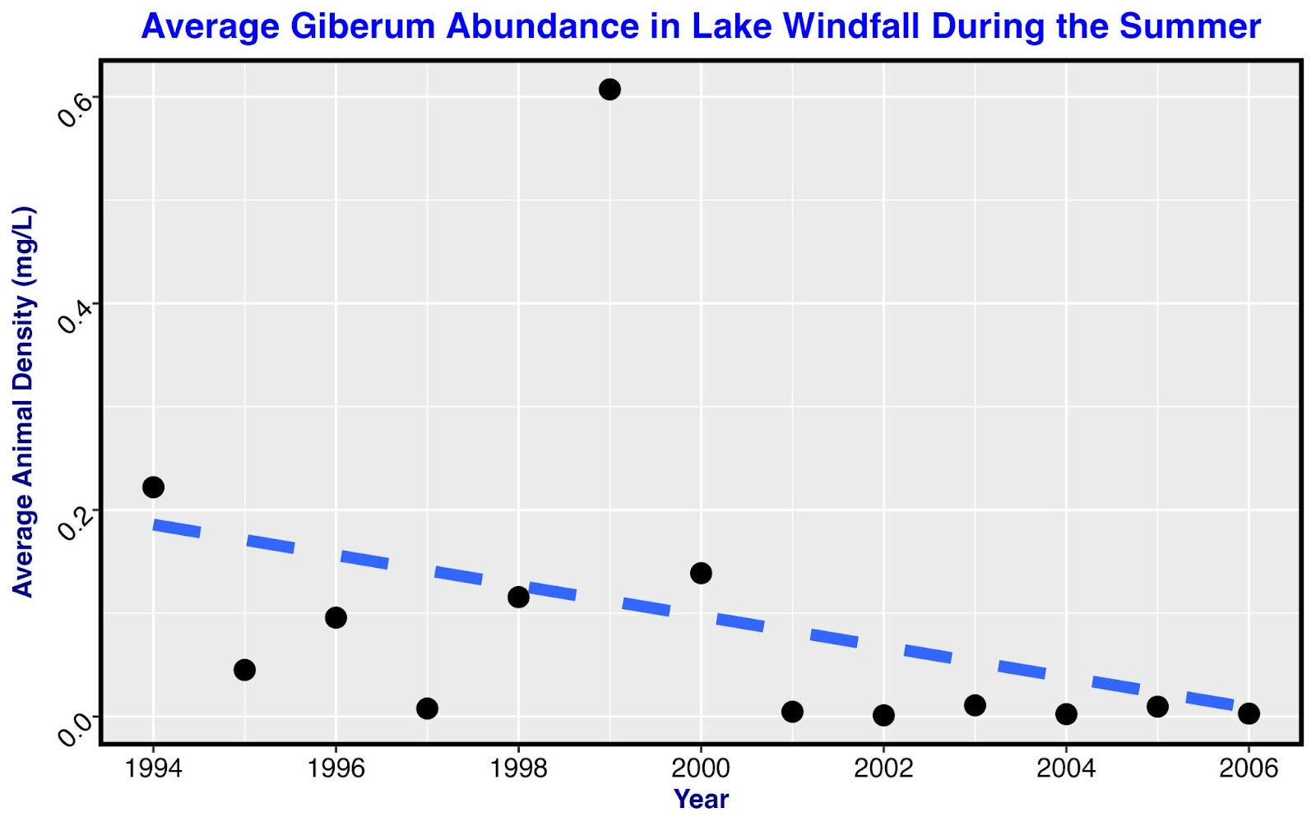
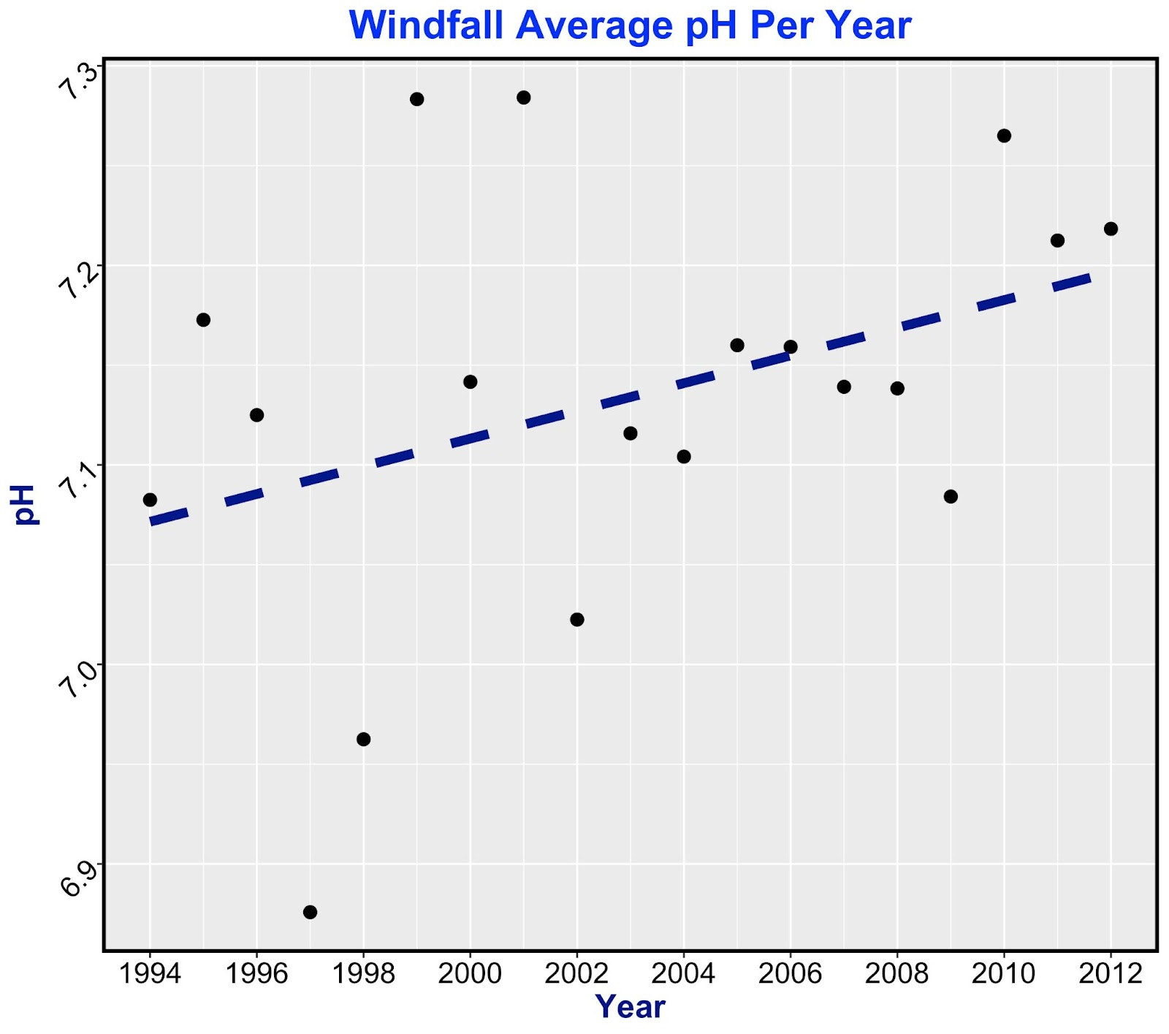
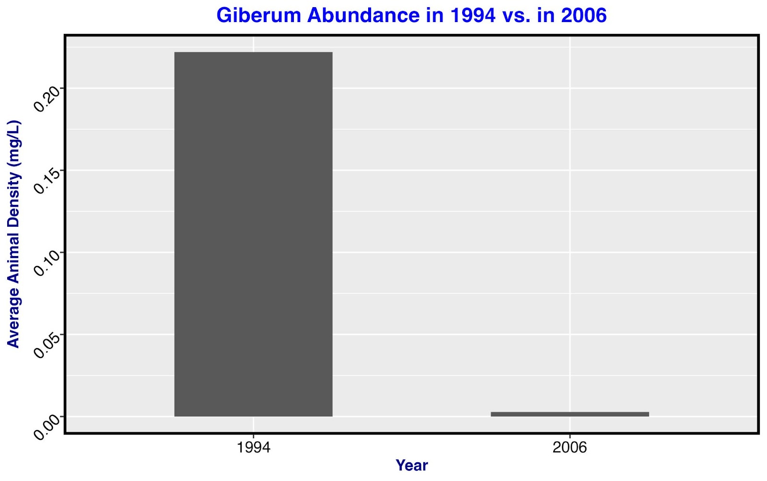
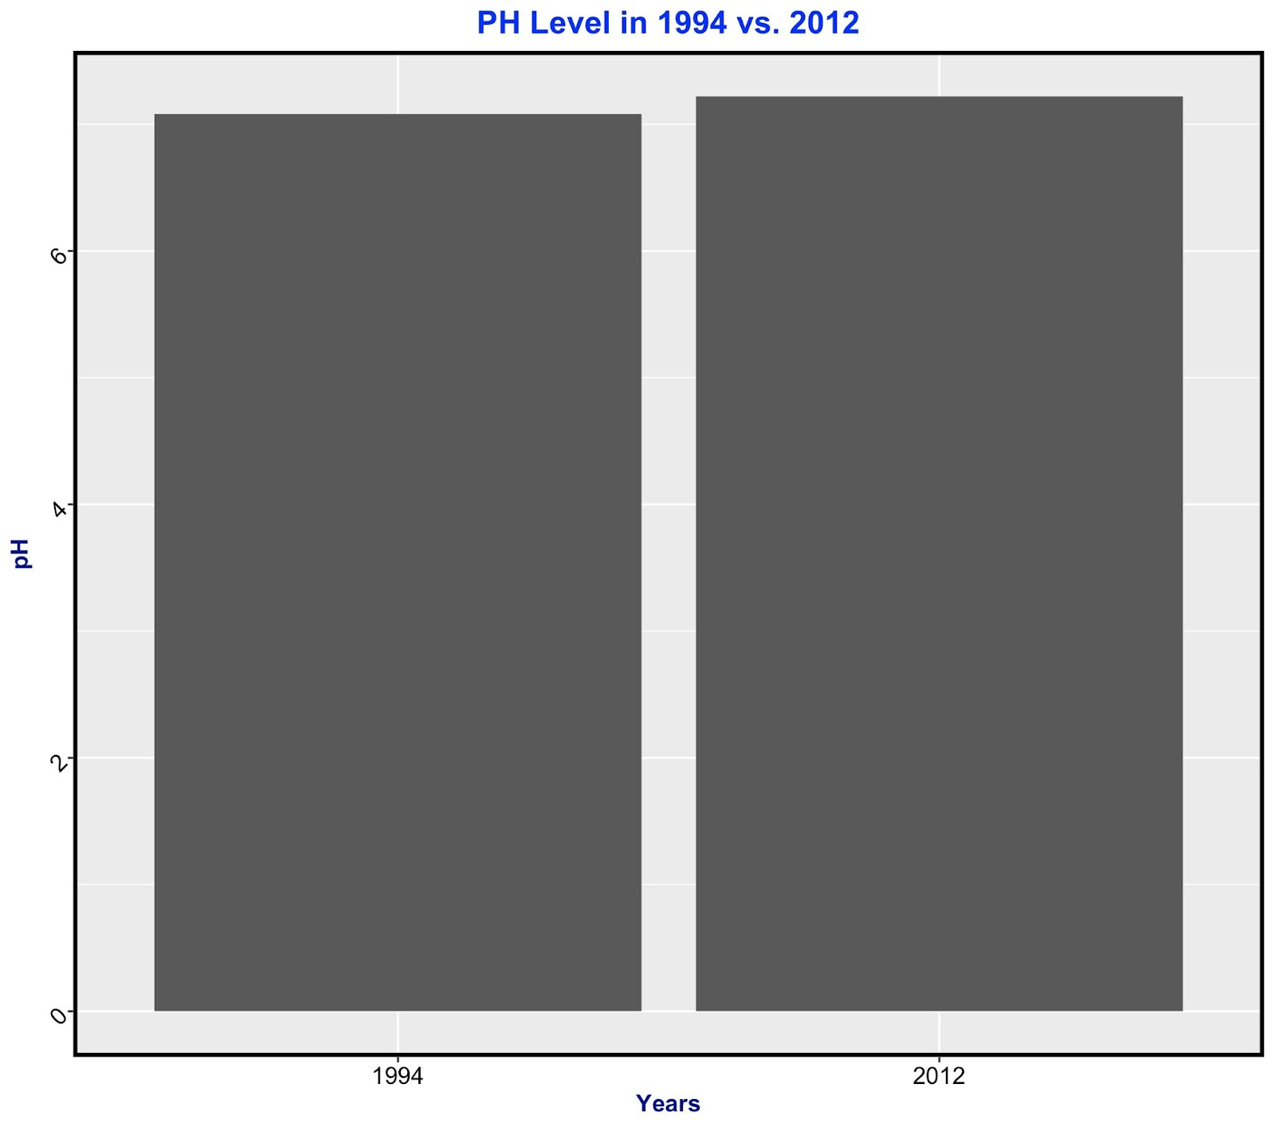
The Effects of Acid Rain in Lake Windfall
RESULTS
INTRODUCTION
Climate change, specifically acid rain, has impacted freshwater ecosystems
Acid rain has been a leading cause of drastic changes in New York lakes like Lake Windfall
Some changes include various animal abundance, pH levels, and phosphorus levels
We will focus on the species holopedium gibberum
Holopedium gibberum abundance in Lake Windfall decreased
pH levels in Lake Windfall increased
Levels of phosphorus in Lake Windfall decreased
The abundance of holopedium gibberum decreased as pH levels increased
ANALYSIS
Holopedium gibberum experienced a significant decline in population
This may have been caused by a small increase in pH levels from acid rain
Phosphorus levels have decreased, decreasing the amount of nutrients for gibberum
METHODS
We used R Studio to filter out the information we wanted to study
We filtered out all the data except the data that was about lake windfall
Then we filtered out all the month besides the summer months. Ex: June, July, and August
Finally, we made graphs using the ggplot library to track the changes in the data we wanted to study
RESOURCES
Leach, Taylor H., et al. “Decoupled Trophic Responses to Long‐Term Recovery from Acidification and Associated Browning in Lakes.” Global Change Biology, vol. 25, no. 5, 27 Feb. 2019, pp. 1779–1792, https://doi.org/10.1111/gcb.14580.
Stetler, Jonathan T., et al. “Lake Browning Generates a Spatiotemporal Mismatch between Dissolved Organic Carbon and Limiting Nutrients.” Limnology and Oceanography Letters, vol. 6, no. 4, 29 May 2021, pp. 182–191, https://doi.org/10.1002/lol2.10194. Accessed 12 Apr. 2023.
Holopedium gibberum abundance in 1994 vs. 2006
pH levels in 1994 vs. 2006

